Slide 1

IST-659 Final Project
SU Marketplace and Collaborative Platform
Eric Lee
Anish Kumar
Komal Sharma

Slide 2

Project Overview
Welcome to SU Marketplace and Collaborative Platform!!
A visionary platform reshaping the fabric of Syracuse University's communal spirit. Beyond a mere marketplace, this dynamic space unites students and faculty in a synergistic exchange where intellectual collaboration seamlessly intertwines with the buying and selling of products at accessible prices.
Rooted in innovation, our project is a testament to the intellectual marketplace that is Syracuse University, fostering a harmonious blend of academic collaboration and economical exchange.

Slide 3
Idea Behind the Project!!!
At the heart of our project lies the vision to create a dynamic and interconnected space within Syracuse University. By integrating collaborative spaces and a cost-effective marketplace, our project aims to nurture a thriving ecosystem where students and faculty can not only engage intellectually but also easily buy and sell essential products. The fusion of academic collaboration and economical exchange is the essence of our endeavor, promising to redefine the university experience and foster a sense of community and shared growth."

Slide 4

Goals
Facilitate Seamless Collaboration
Establish an Affordable Marketplace
Enhanced Connectivity
Streamlined Transactions
Promote Sustainability
Foster Innovation
Build a Sense of Community
Ensure User-Friendly Experience
Adaptability and Scalability
Promote Economic Inclusivity

Slide 5
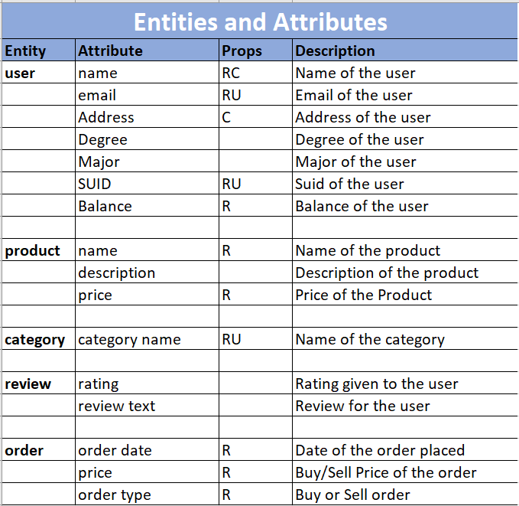
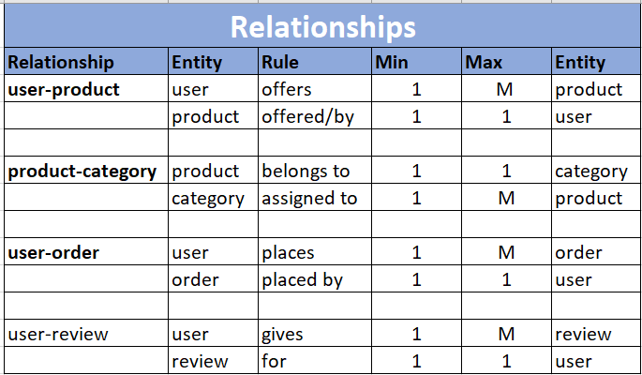
Data Requirements

Slide 6

Conceptual Model

Slide 7
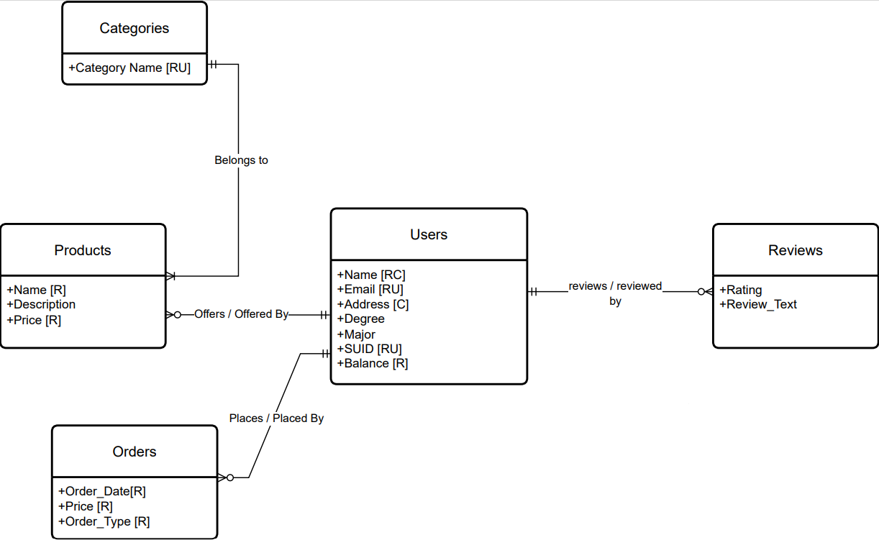

Slide 8
Logical Model

Slide 9
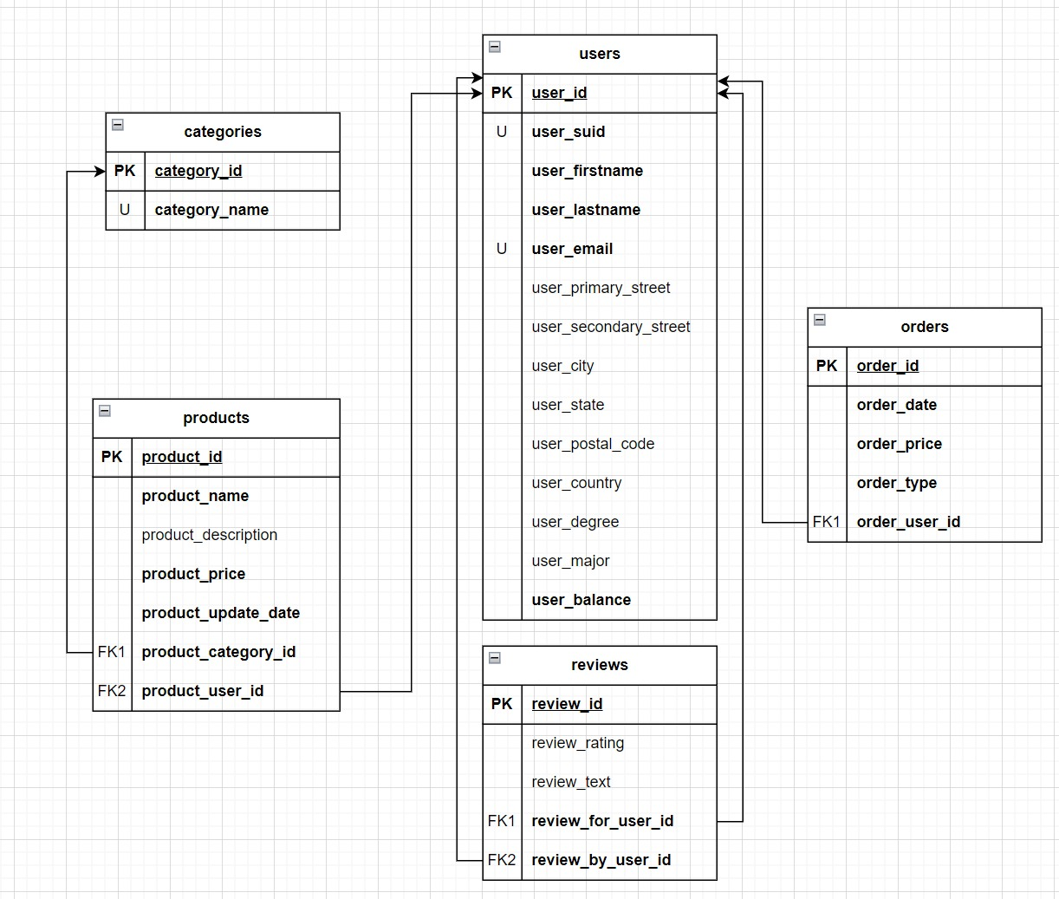

Slide 10
Demonstration

Slide 11
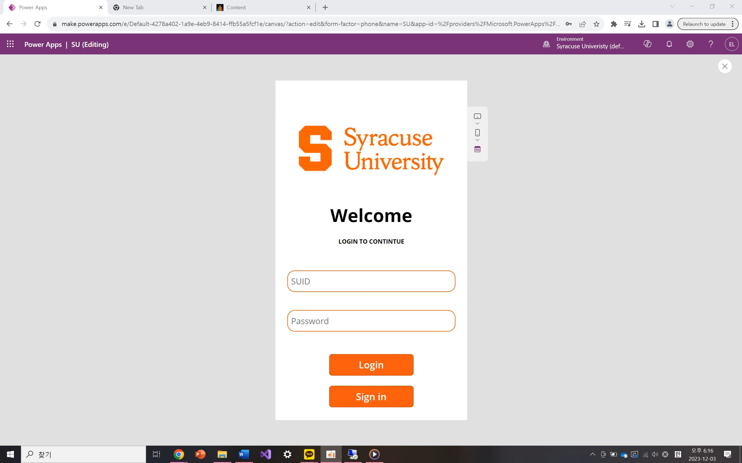

Slide 12
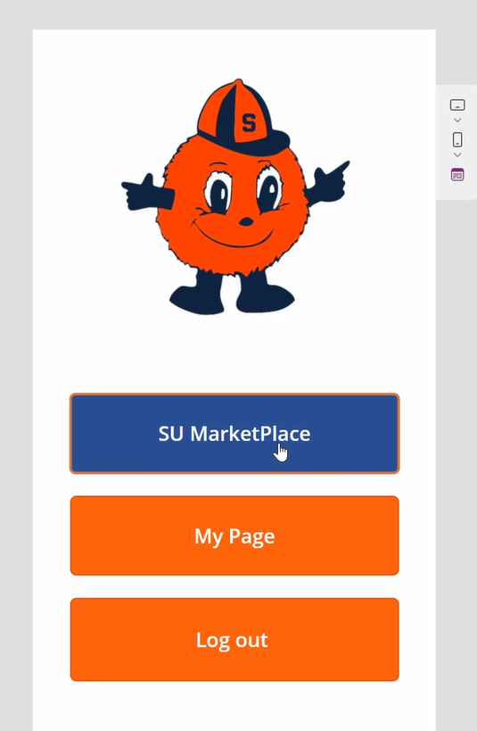
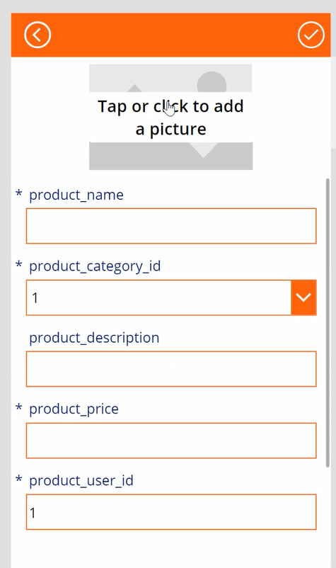
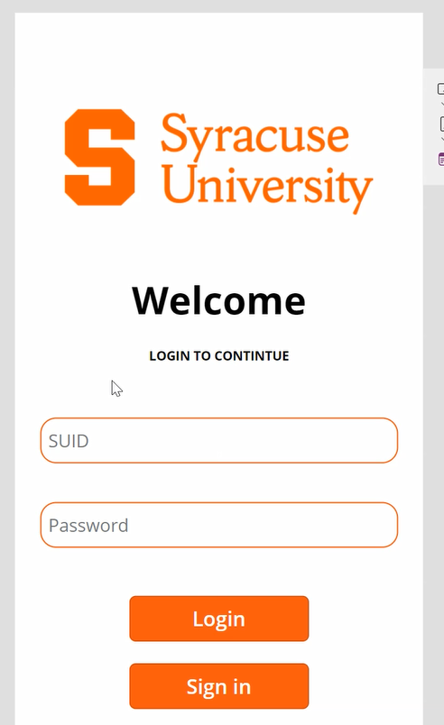
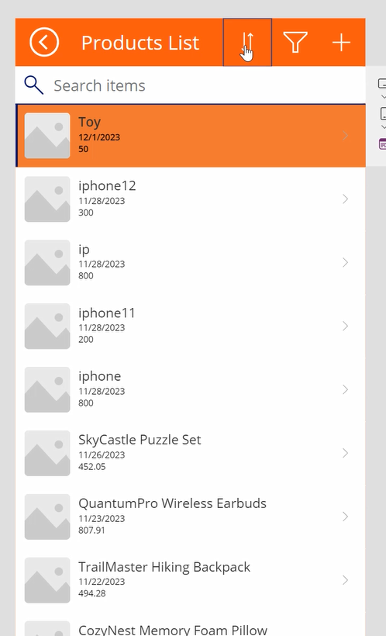
Logical Design of UI Layout

Slide 13

Area of Improvements
User Experience (UX): Collect user feedback for iterative design improvements. Ensure a seamless and enjoyable user experience.
Marketplace Functionality: Enhance search and filtering for improved product discovery. Strengthen security measures for secure transactions.
Collaborative Spaces: Expand features in collaborative spaces for advanced project management. Implement a robust notification system for project updates.
Communication Tools: Explore real-time communication features for instant interactions. Consider adding group messaging capabilities.
Mobile Responsiveness: Ensure consistent/optimal experiences across devices. Prioritize mobile design enhancements based on user preferences.

Slide 14

Challenges
Technical Complexity:
Challenge: Navigating the technical intricacies of developing an integrated marketplace features.
Mitigation: Engaged experienced developers, conducted thorough research, and leveraged proven technologies to address technical complexities.
User Requirements Understanding:
Challenge: Gaining a deep understanding of the diverse requirements of students and faculty for both collaborative spaces and a marketplace.
Mitigation: Conducted user interviews, surveys, and involved potential users in the design and testing process to gather valuable insights.
Built a collaborative platform like Blackboard:
Challenge: Integrating the platform like the existing blackboard.
Mitigation: Collaborated closely with university IT teams, allocated sufficient time for integration testing, and addressed compatibility issues promptly. Still needs work.
Chatting feature:
Challenge: Implementing a chat function integrated with Power Apps presented difficulties in achieving real-time communication.
Mitigation: Considering alternative communication platforms with robust APIs or consulting Power Apps experts could enhance our ability to deliver an effective and responsive chat feature for a seamless user experience in our marketplace. Still needs work.

Slide 15

Thank You!
Any Questions?

